Slide 1
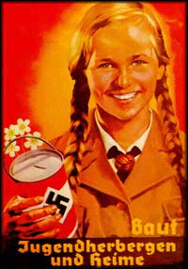
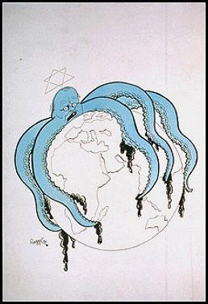
Anti -Semitism
This is the term given to political, social and economic agitation against Jews. In simple terms it means ‘Hatred of Jews’.
Aryan Race
This was the name of what Hitler believed was the perfect race. These were people with full German blood, blonde hair and blue eyes.

Slide 2
For hundreds of years Christian Europe had regarded the Jews as the Christ -killers. At one time or another Jews had been driven out of almost every European country. The way they were treated in England in the thirteenth century is a typical example.
In 1275 they were made to wear a yellow badge.
In 1287 269 Jews were hanged in the Tower of London.
Jews were a SCAPEGOAT
This deep prejudice against Jews was still strong in the twentieth century, especially in Germany, Poland and Eastern Europe, where the Jewish population was very large.
After the First World War hundreds of Jews were blamed for the defeat in the War. Prejudice against the Jews grew during the economic depression which followed. Many Germans were poor and unemployed and wanted someone to blame. They turned on the Jews, many of whom were rich and successful in business.

Slide 3
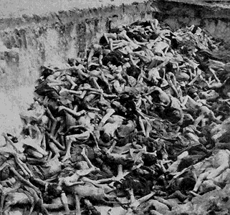
Between 1939 and 1945 six million Jews were murdered, along with hundreds of thousands of others, such as Gypsies, Jehovah’s Witnesses, disabled and the mentally ill.

Slide 4
Percentage of Jews killed in each country
POLAND 91%
AUSTRIA 35%
USSR 36%
BELGIUM 45%
NORWAY 45%
LUXEMBOURG 55%
ROMANIA 84%
ESTONIA 44%
A Total of 6,000,000 Jews
HUNGARY 74%
BOHEMIA 60%
YUGOSLAVIA 81%
LATVIA 84%
NETHERLANDS 71%
LITHUANIA 85%
GERMANY 36%
FRANCE 22%
GREECE 87%
Notes:
How did they manage to get together all these Jews to kills them?
How did they kill them when they had them?
To begin with there were concentration camps.

Slide 5
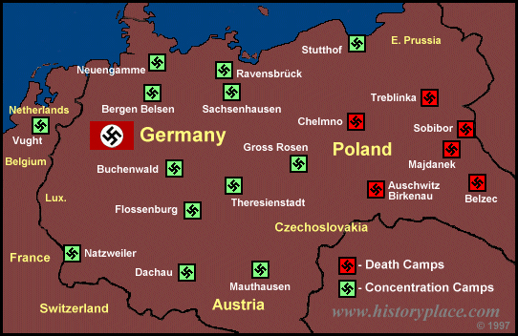
A MAP OF THE CONCENTRATION CAMPS AND DEATH CAMPS USED BY THE NAZIS.
Notes:
There were concentration camps and death camps. If you went to a death camp the chances of coming out alive were virtually nil.
Even at concentration camps though you were likely to die from the appalling conditions.
Or, if you were very young, old, or incapable of hard labour, it was likely you would be transferred to a death camp too.
Anne Frank died at Belsen from Typhoid.
Leonard Leher's mother and sisters were sent to Sobibor.
YOU MAY ASK "WHO WERE THESE PEOPLE WHO WERE SENT TO PLACES LIKE THIS?"
THEY WERE CHILDREN JUST LIKE YOU. THE ONLY DIFFERENCE WAS THEIR RACE AND THE RELIGION THEY FOLLOWED.

Slide 6
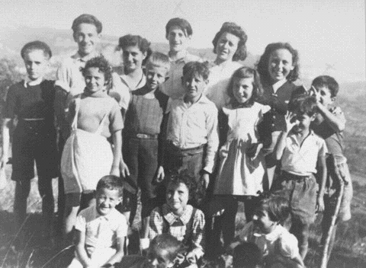
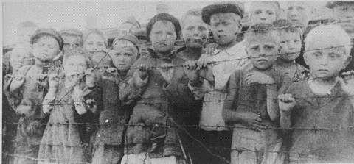
16 of the 44 children taken from a French children’s home.
They were sent to a concentration camp and later to Auschwitz.
ONLY 1 SURVIVED
A group of children at a concentration camp in Poland.
Notes:
HOW DID THEY KILL THESE INNOCENT CHILDREN, ALONG WITH THEIR PARENTS, GRANDPARENTS, FRIENDS ETC..
YOU WILL ALL HAVE PROBABLY HEARD OF THE WAY NAZiS GASSED THE JEWS.

Slide 7
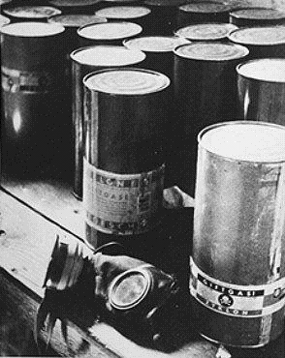
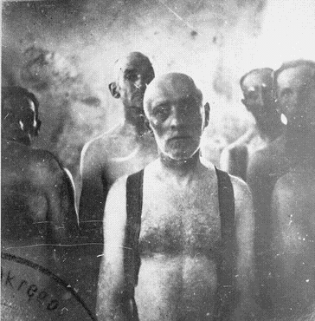
Part of a stockpile of Zyklon-B poison gas pellets found at Majdanek death camp.
Before poison gas was used , Jews were gassed in mobile gas vans. Carbon monoxide gas from the engine’s exhaust was fed into the sealed rear compartment. Victims were dead by the time they reached the burial site.
Notes:
THIS IS THE GAS THAT WAS INTRODUCED IN 1942.
JEWS WERE SENT INTO SEALED SHOWER UNITS ON THE PRETENCE THAT THEY WERE GOING TO BE SHOWERED. PELLETS WERE THEN PLACED INTO THE SHOWER HEADS AND GAS CAME FROM THE SHOWERS INSTEAD OF WATER.
15 MINUTES LATER THE SHOWER ROOM WOULD BE EMPTIED, BODIES WERE ALWAYS IN A PYRAMID SHAPE, PEOPLE TRIED TO CLIMB ON TOP OF ONE ANOTHER TO ESCAPE THE GAS.
BEFORE THIS TYPE OF KILLING METHOD WAS INTRODUCED THOUGH A MORE PRIMITIVE GASSING METHOD WAS USED....
I DON'T KNOW HOW, OR EVEN WHY THIS PHOTO WAS TAKEN, BUT IT SHOWS SOME MEN AWAITING DEATH ON THEIR WAY TO THEIR BURIAL PLACE.
DID THEY ALWAYS BURY THE DEAD?

Slide 8
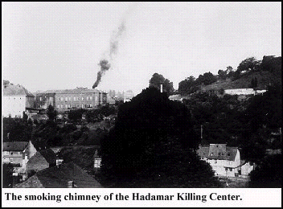
Smoke rises as the bodies are burnt.
Notes:
NO.
MORE OFTEN THAN NOT, ESPECIALLY WHEN THE NUMBER OF PEOPLE MURDERED GREW ESPECIALLY HIGH, NAZIS BURNED THE BODIES.
SO WHAT OTHER METHODS WERE USED TO SYSTEMATICALLY MURDER THESE PEOPLE?

Slide 9
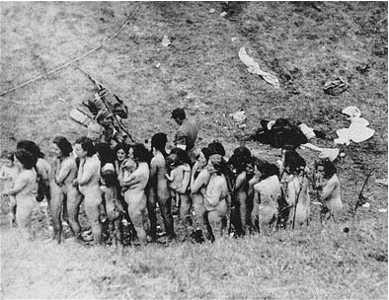
Jewish women, some holding infants, are forced to wait in a line before their execution by Germans and Ukrainian collaborators.
Notes:
MASS EXECUTION USING A FIRING SQUAD WAS COMMON.
THESE WOMEN HAVE BEEN ORDERED TO REMOVE EVERYTHING, CLOTHES, JEWELLERY, EVEN WEDDING RINGS AND ARE BEING FORCED TO LINE UP AND WAIT FOR THEIR TURN TO BE KILLED.
SOME TIME LATER...

Slide 10
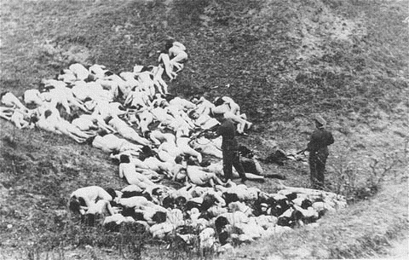
A German policeman shoots individual Jewish women who remain alive in the ravine after the mass execution.
Notes:
THEY HAVE BEEN ORDERED TO LIE, FACE DOWN ON THE GROUND AND HAVE BEEN SHOT.
THE GERMAN POLICEMAN IS SHOOTING INDIVIDUALS WHO HAVE ESCAPED DEATH FROM THE INITIAL ROUND OF BULLETS.
THIS IS HORRIFIC BUT WE CANNOT SEE THE INDIVIDUAL FACES OF THOSE KILLED, WE DON'T REALLY KNOW WHO THEY ARE OR WHAT THEY REALLY LOOKED LIKE.
SO TAKE A LOOK AT THIS NEXT PICTURE...

Slide 11
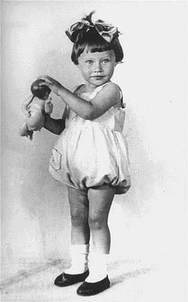
Portrait of two-year-old Mania Halef, a Jewish child who was among the 33,771 persons shot by the SS during the mass executions at Babi Yar, September, 1941.
Notes:
THIS PICTURE TELLS US A LOT.
HER PARENTS ARE OBVIOUSLY WEALTHY ENOUGH TO HAVE HAD A PORTRAIT DONE, SO IT SHOWS US THAT THE STATUS OF THE JEWS DID NOT MATTER TO THE NAZIS. IT WAS NOT JUST THE POOR WHICH WERE KILLED.
THEY WERE KILLED REGARDLESS OF WEALTH OR STATUS, THEIR DEATH WAS DETERMINED BY RELIGION AND RACE.

Slide 12
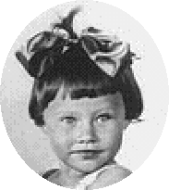
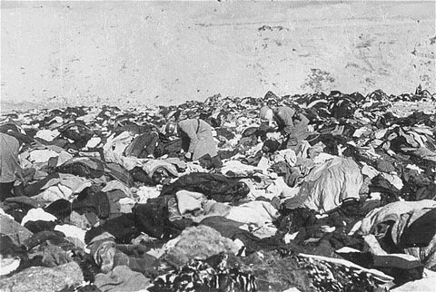
Nazis sift through a huge pile of clothes left by victims of the massacre.
Two year old Mani Halef’s clothes are somewhere amongst these.
Notes:
GIVES SOME IDEA OF THE NUMBER OF PEOPLE.
BUT WHY DID THE NAZI WANT THEM TO REMOVE THEIR CLOTHES?
WHAT DID THEY WANT WITH THEIR JEWELLERY, CLOTHES, EVEN HAIR?

Slide 13
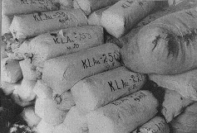
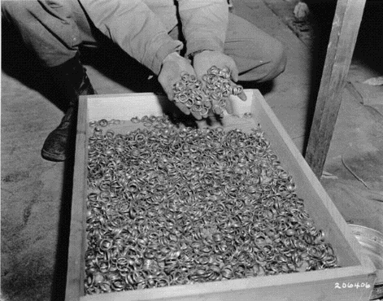
Bales of hair shaven from women at Auschwitz, used to make felt-yarn.
After liberation, an Allied soldier displays a stash of gold wedding rings taken from victims at Buchenwald.
Notes:
THESE PICTURES SHOW WHAT THEY WANTED.
WERE THE NAZI'S NOT WORRIED ABOUT THE CONSEQUENCES OF THEIR ACTIONS?
DID THEY NOT THINK ABOUT WHAT MIGHT HAPPEN IF ALLIED COUNTRIES DISCOVERED WHAT WAS HAPPENING?

Slide 14
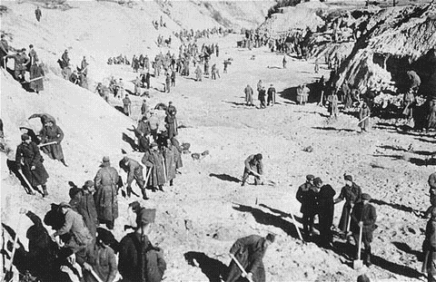
In 1943, when the number of murdered Jews exceeded 1 million. Nazis ordered the bodies of those buried to be dug up and burned to destroy all traces.
Soviet POWs at forced labor in 1943 exhuming bodies in the ravine at Babi Yar, where the Nazis had murdered over 33,000 Jews in September of 1941.
Notes:
OBVIOUSLY TOWARDS THE END OF THE WAR THEY TRIED TO COVER THEIR TRACKS.
IT WAS NOT GUILT THOUGH AND THEY DID NOT DO THE WORK THEMSELVES. THEY MADE JEWS AND OTHER PRISONERS OF WAR DIG UP THE BODIES AND BURN THEM INSTEAD.

Slide 15
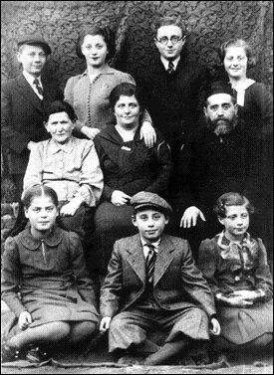
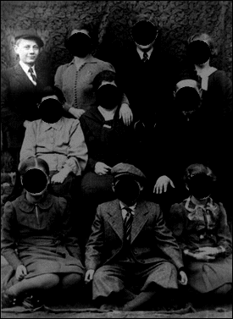
“Until September 14, 1939 my life was typical of a young Jewish boy in that part of the world in that period of time.
I lived in a Jewish community surrounded by gentiles. Aside from my immediate family, I had many relatives and knew all the town people, both Jews and gentiles. Almost two weeks after the outbreak of the war and shortly after my Bar Mitzvah, my world exploded.
In the course of the next five and a half years I lost my entire family and almost everyone I ever knew. Death, violence and brutality became a daily occurrence in my life while I was still a young teenager.”
Leonard Lerer, 1991
WHY?
Notes:
THIS PICTURE IS IMPORTANT BECAUSE IT SHOWS A FAMILY WHOSE LIVED THROUGH THIS AWFUL TIME.
WE WILL BE LOOKING AT A BOOK CALLED THE SOAPMAKER WHICH TELLS THE STORY OF A YOUNG POLISH BOY'S LIFE THROUGHOUT THE WAR.
AFTER ALL THAT HORRIFIC EVIDENCE OF WHAT HAPPENED THERE SHOULD ONLY BE ONE QUESTION ON YOUR MINDS. A QUESTION WHICH WE WILL TRY TO ANSWER OVER THE NEXT FEW LESSONS....
(MOUSE CLICK) WHY.

